Slide 1
SVD
Singular Value Decomposition
Dimensionality Reduction Technique

Slide 2
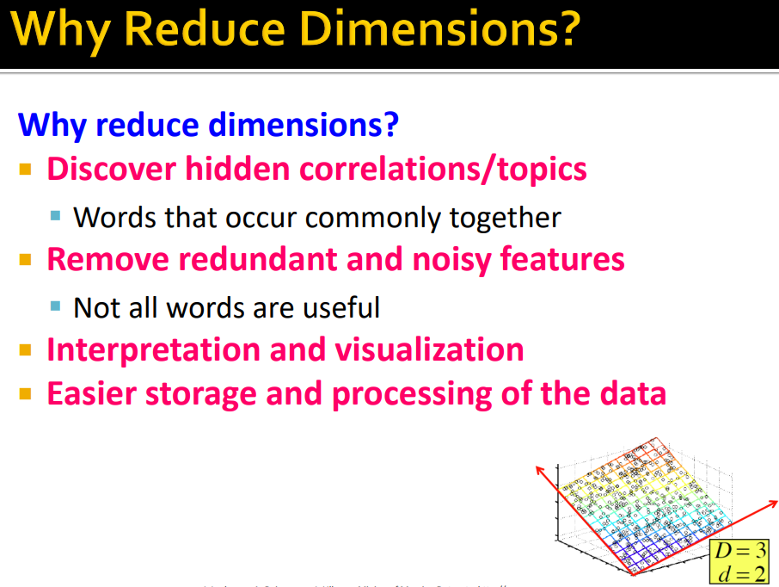

Slide 3
SVD
The input matrix of users-ratings is broken down into 3 matrices of user-features, features-features and item-features matrices using a technique called Singular Value Decomposition (SVD).
It is a matrix decomposition technique.

Slide 4
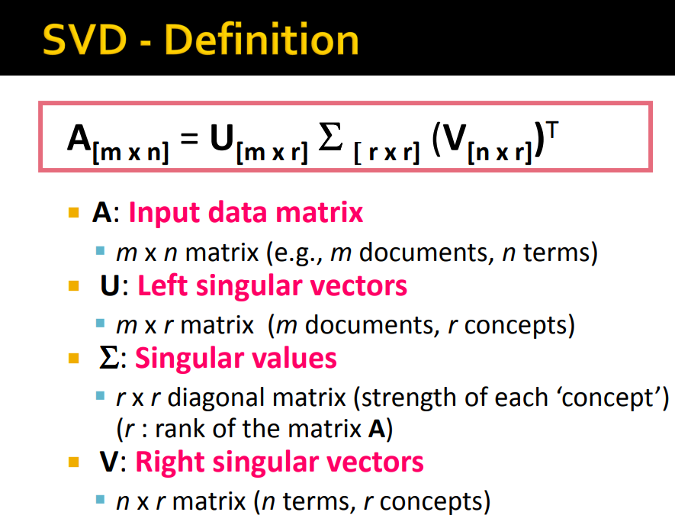

Slide 5
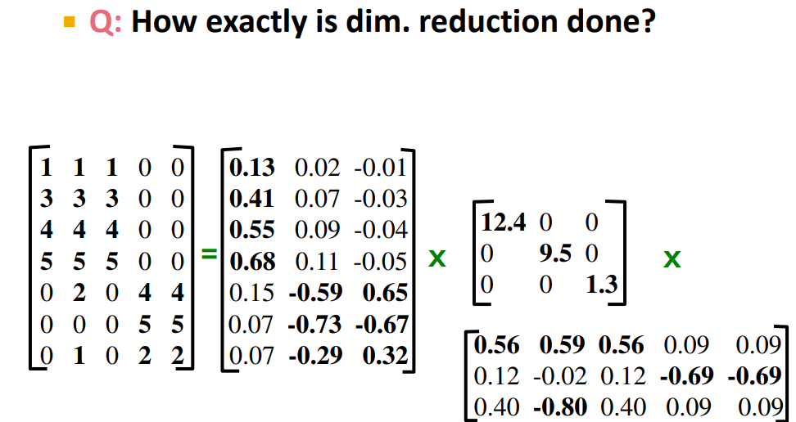

Slide 6
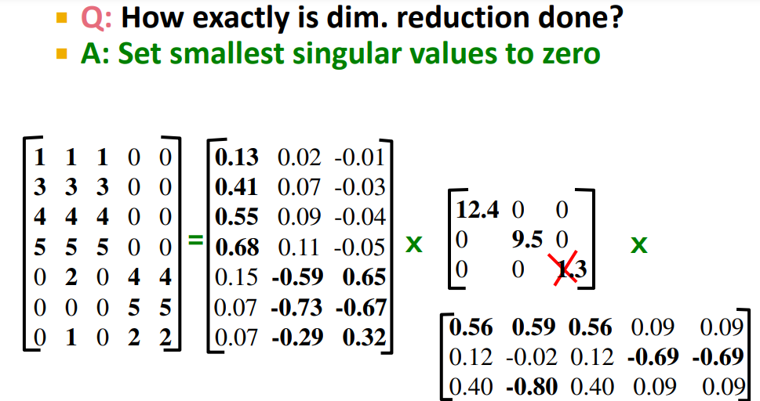

Slide 7
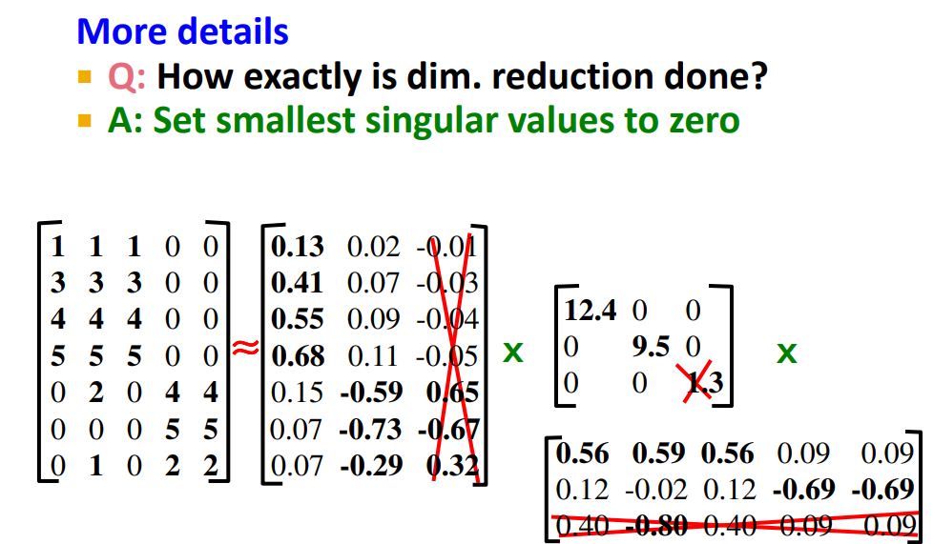

Slide 8
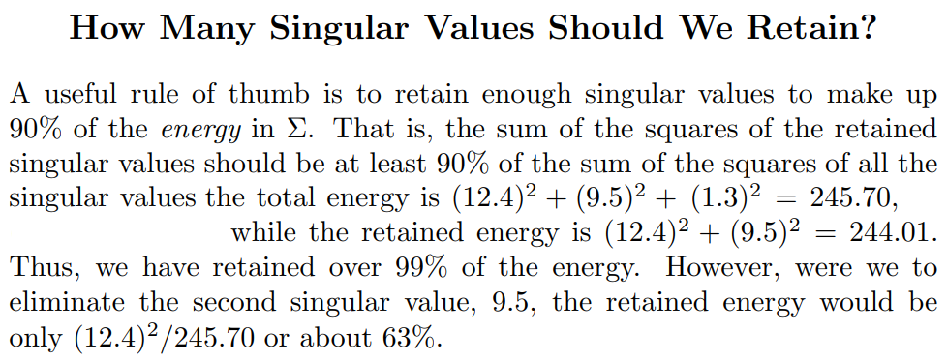

Slide 9
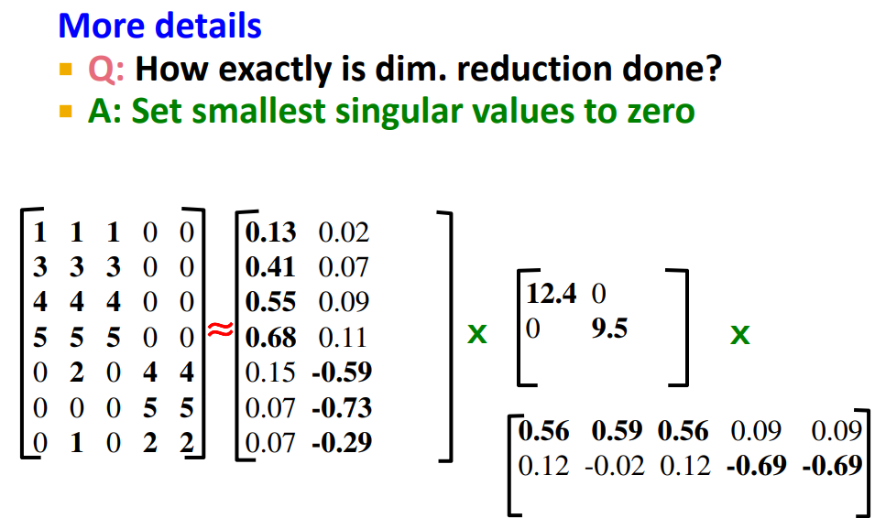

Slide 10
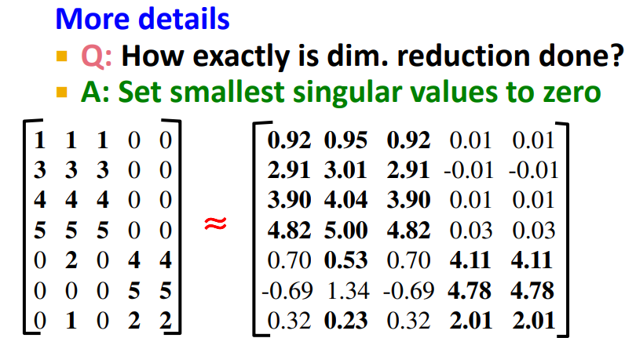

Slide 11
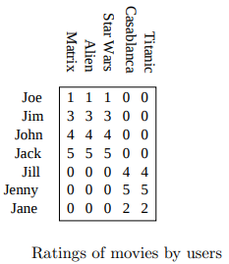

Slide 12
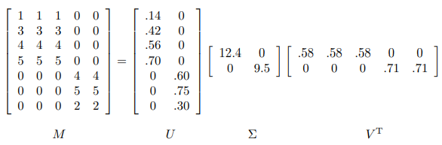

Slide 13
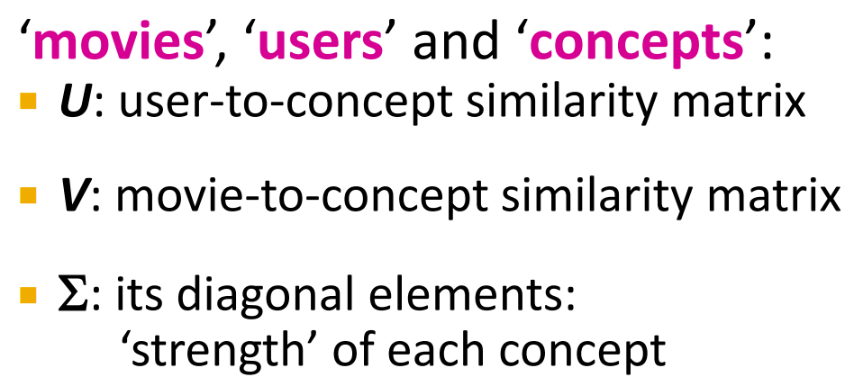

Slide 14
Matrix U
Let us think of the rows of M as people and the columns of M as movies. Then matrix U connects people to concepts. For example, the person Joe, who corresponds to row 1 of M, likes only the concept science fiction. The value 0.14 in the first row and first column of U is smaller than some of the other entries in that column, because while Joe watches only science fiction, he doesn’t rate those movies highly. The second column of the first row of U is 0, because Joe doesn’t rate romance movies at all.

Slide 15
Matrix V
The matrix V relates movies to concepts. The 0.58 in each of the first three columns of the first row of V^{T} indicates that the first three movies – The Matrix, Alien, and Star Wars – each are of the science-fiction genre, while the 0’s in the last two columns of the first row say that these movies do not relate romance concept at all. Likewise, the second row of V^{T} tells us that the movies Casablanca and Titanic are exclusively romances

Slide 16
matrix Σ
The matrix Σ gives the strength of each of the concepts. In our example, the strength of the science-fiction concept is 12.4, while the strength of the romance concept is 9.5. Intuitively, the science-fiction concept is stronger because the data provides more information about the movies of that genre and the people who like them.

Slide 17
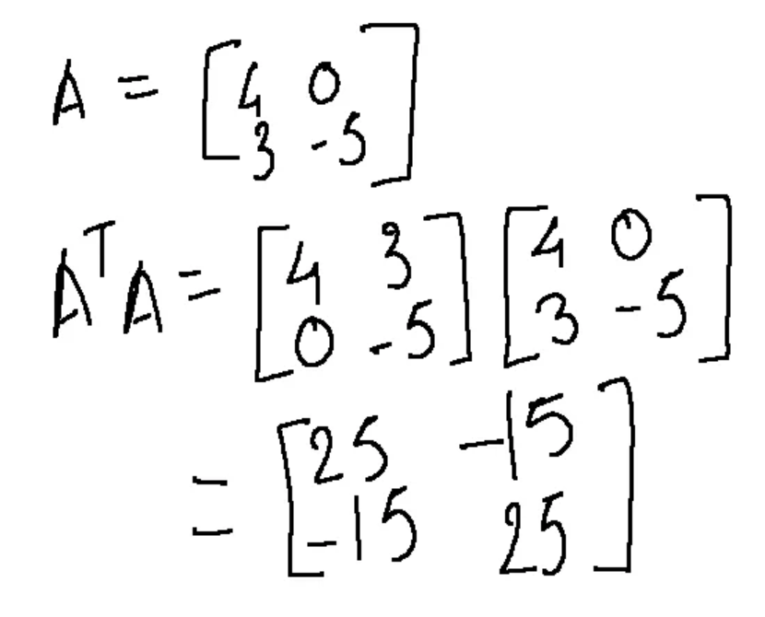
Step I - To find eigenvalues
As A can be a rectangular matrix, we need to convert it to a square matrix by multiplying A with its transpose.

Slide 18
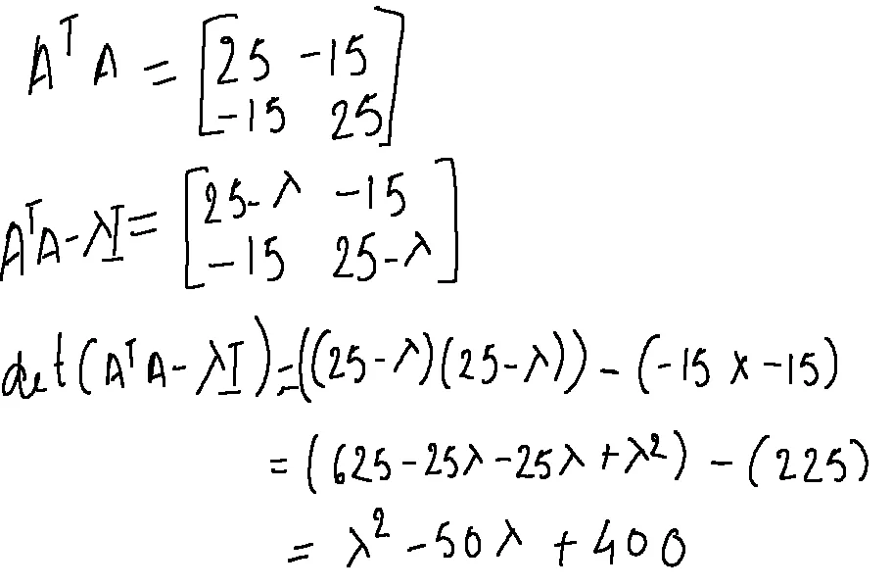

Slide 19
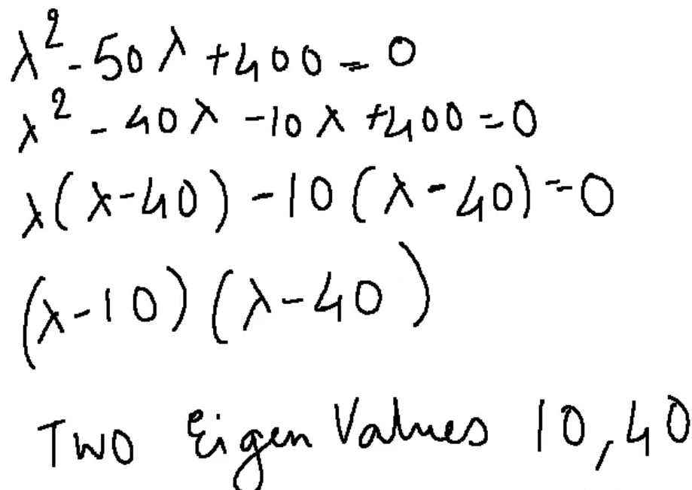

Slide 20
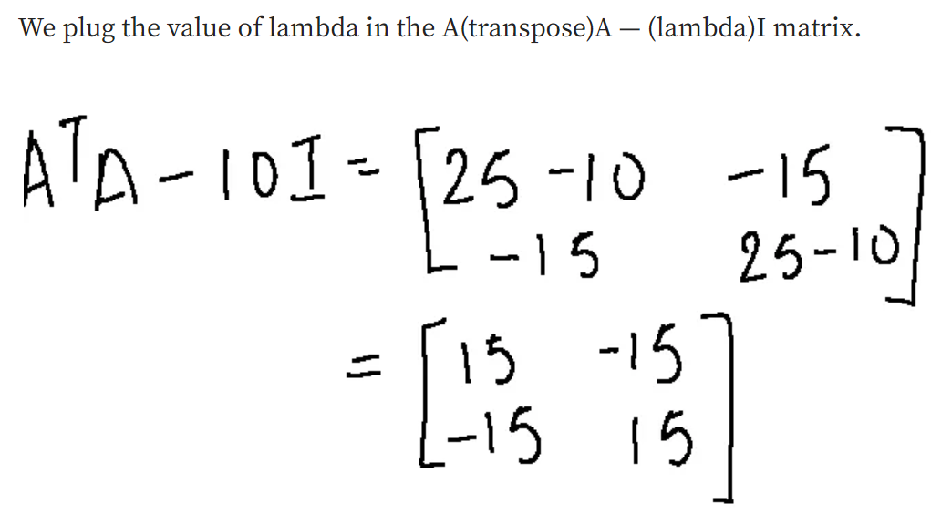

Slide 21
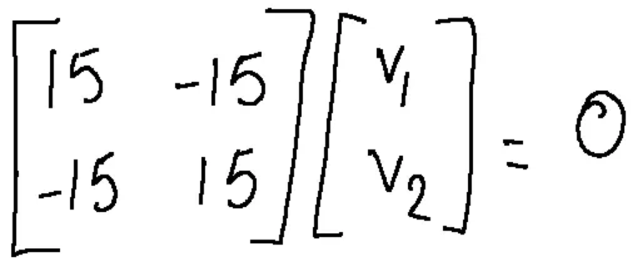
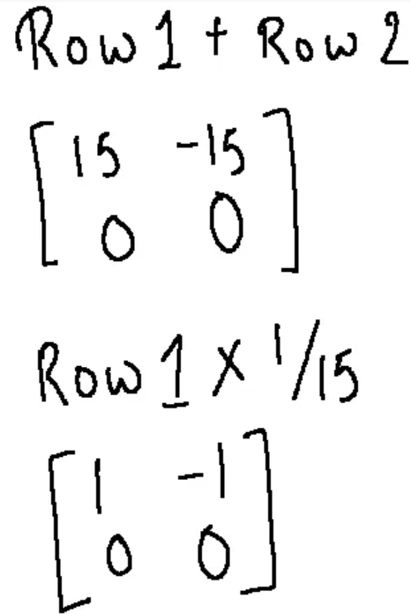
Step II - To find the eigenvector

Slide 22
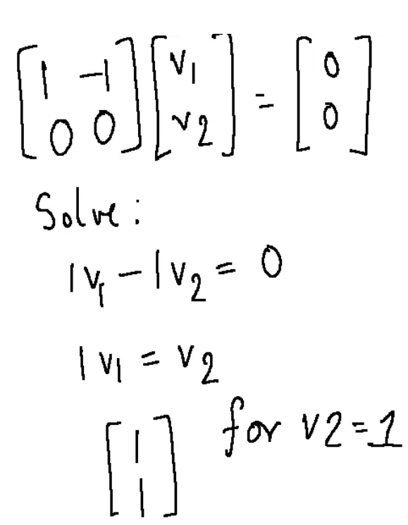

Slide 23
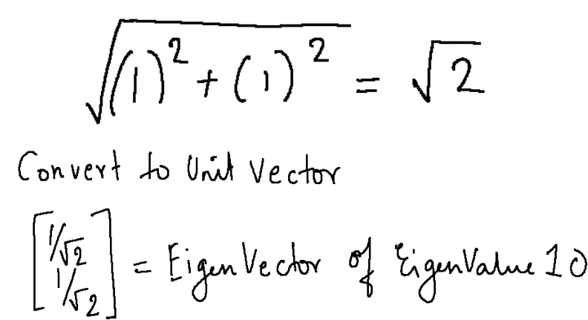

Slide 24
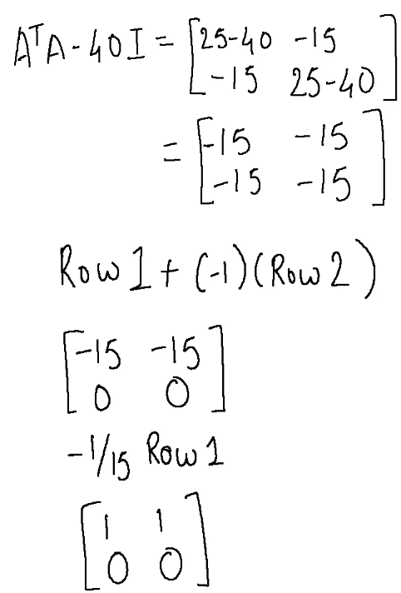
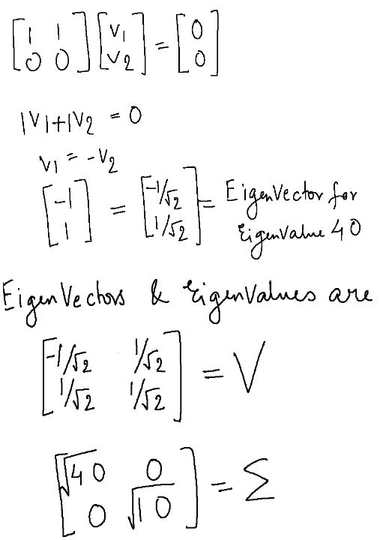
To get the eigenvector for eigenvalue 40

Slide 25
Note that the diagonal values in sigma are always in the descending order and so the vectors are also placed in that corresponding order. The top k diagonal elements capture the most variance. The higher the value, the more important the component is and the more variance they describe.

Slide 26
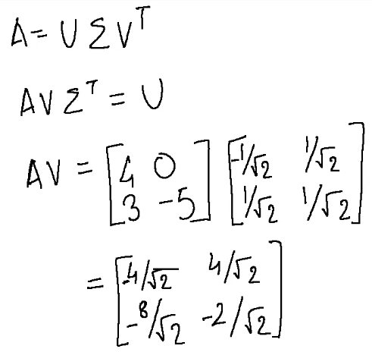
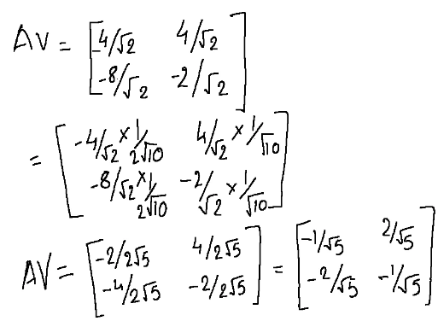
To find U matrix

Slide 27
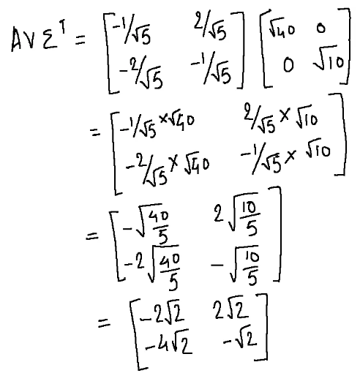

Slide 28
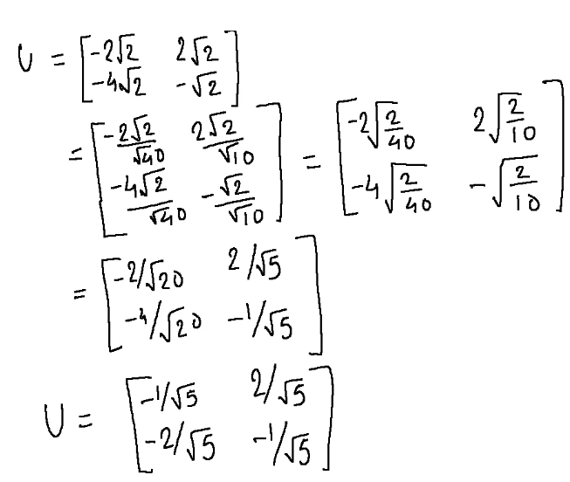

Slide 29
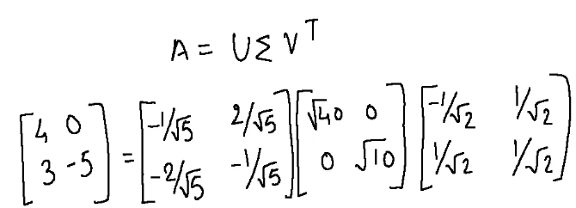
So, we have calculated U, sigma and V and decomposed the matrix A into three matrices as given below.

Slide 30

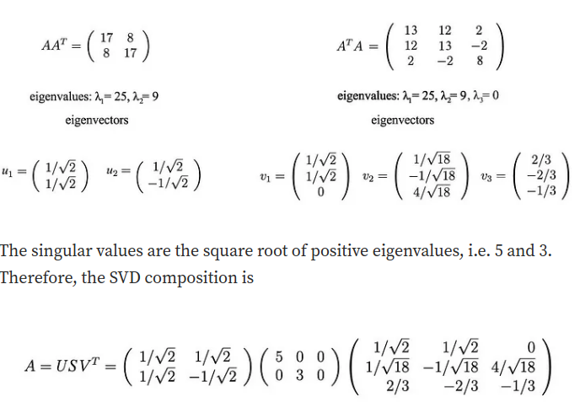
Example

Slide 31
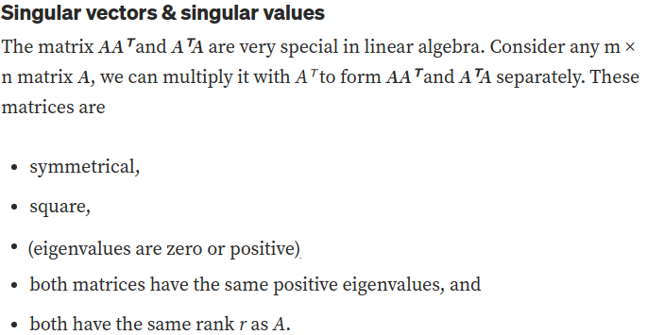

Slide 32
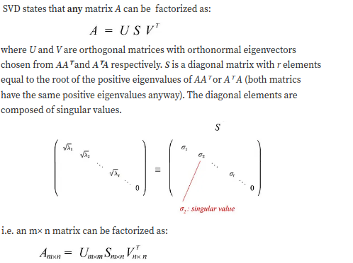

Slide 33
